Slide 1
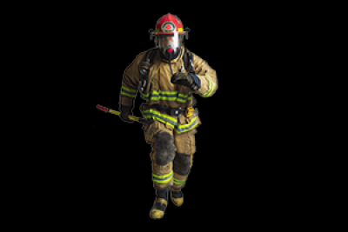
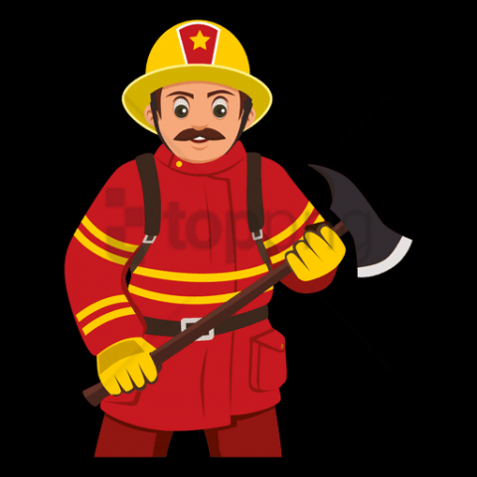
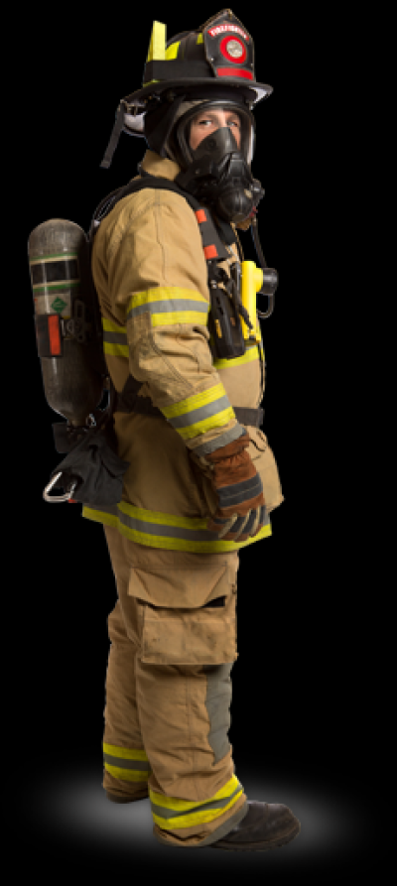


FIREFIGHTER
Student: Džiugas Pečiulevičius
Group: PI18E

Slide 2
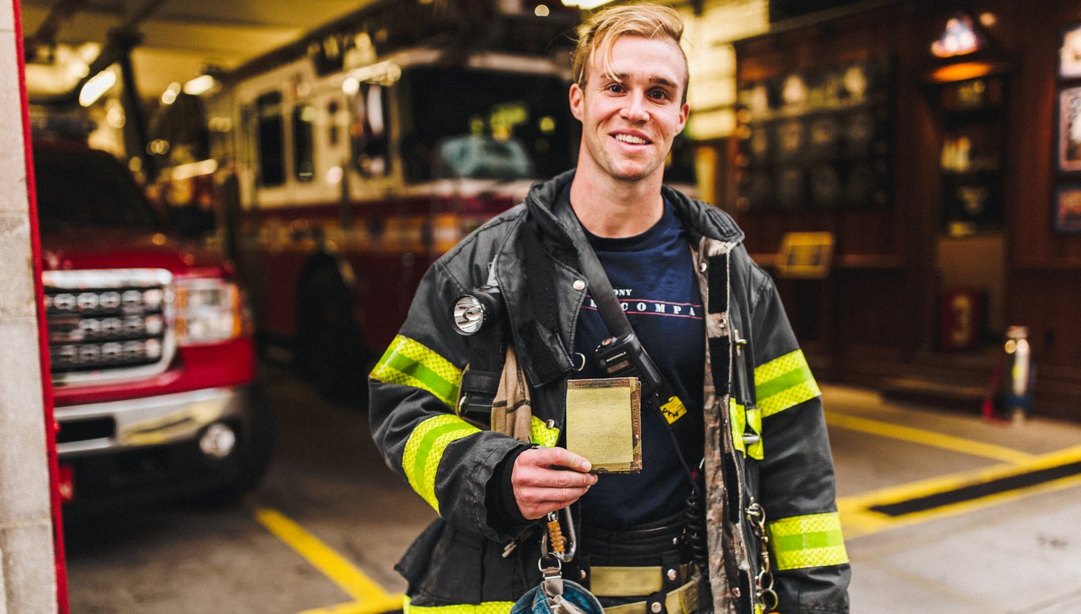
About the profession
A firefighter is a rescuer extensively trained in firefighting, primarily to extinguish hazardous fires that threaten life, property and the environment as well as to rescue people and animals from dangerous situations as well rescuing people from crashed cars or any other situation.

Slide 3
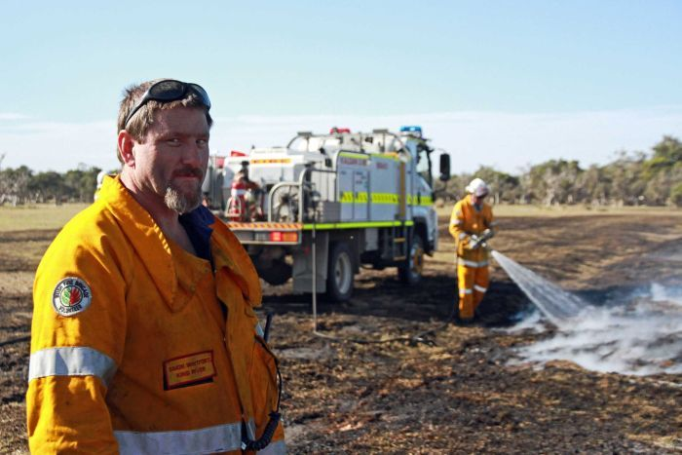
Biological hazards
Exposure to communicable diseases and rescue work in the event of a dirty bomb explosion.
Exposure to infectious diseases including blood borne diseases such as AIDS and hepatitis B and C.
Blood and Body Fluids
Mold and Fungi
Sewage (waste water and excrement conveyed in sewers.)
Animal and Bird Droppings, Insects, bites
Harmful plants
FIXING SOME OF THESE HAZARDS:
Working in a team incase any of these hazards appear and be able to help each other. Also having a proper equipment and clothing to protect themselves from any kind of dangers would prevent these hazards.

Slide 4
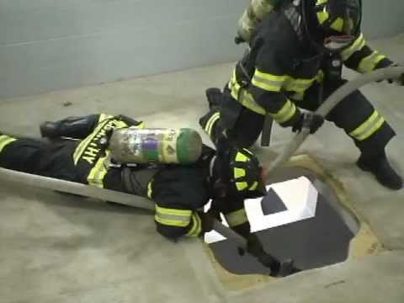
Physical hazards
Flashovers or injuries from back drafts
Burns
Exposure to loud noises
Exposure to cold during the winter or in maritime rescues.
Wild dogs or some other creatures might be present in the buildings.
FIXING SOME OF THESE HAZARDS:
- To reduce injuries, it would be a good idea to make firefighters undergo more training and give more rest time.
- To reduce exposure to noises, firefighters should wear ear protection.
- Firefighters should take super care of aggressive animals and have special clothes

Slide 5
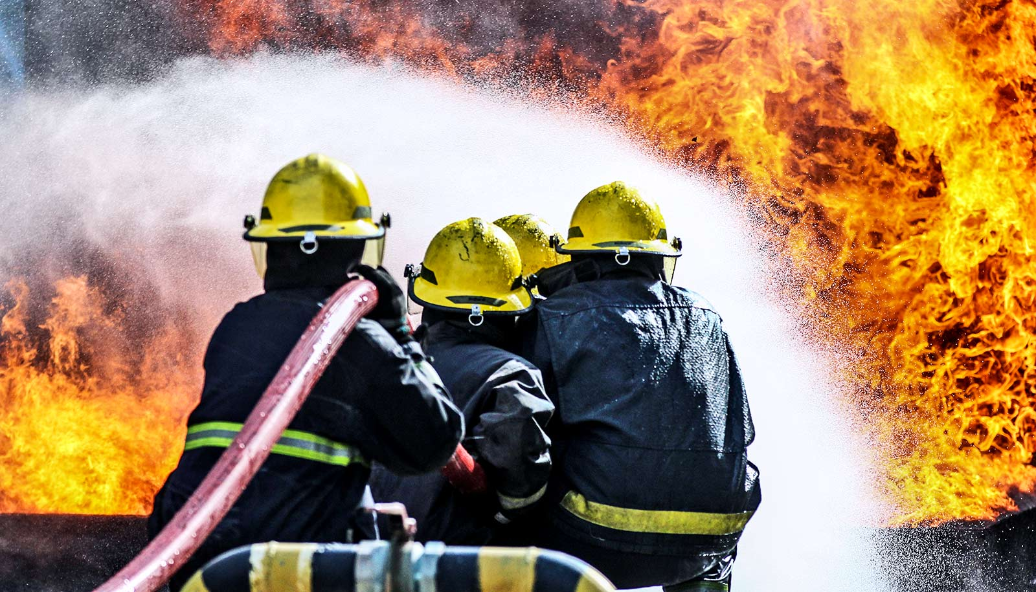
Chemical hazards
Inadequate fresh air to breathe
Exposure to chemicals during a rescue
Inhalation of chemical vapors
Exposure to large quantities of carbon monoxide
FIXING SOME OF THESE HAZARDS:
- Improve firefighters clothing and equipment to reduce exposure to all kind of vapor and carbon monoxide.

Slide 6
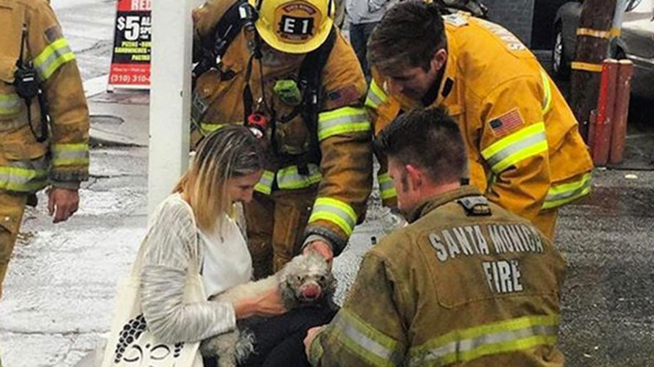
Psychological hazards
Work pace
Overworking
Fatigue
Shift work
FIXING SOME OF THESE HAZARDS:
- One of the solutions would be to find and hire more firefighters, so there would be more time to rest for the firefighters.

Slide 7
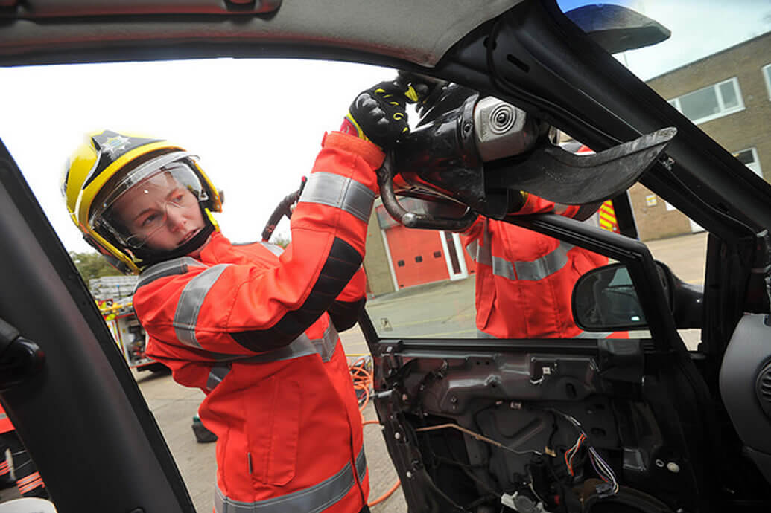
Ergonomic hazards
There are many situations where physical demands involve force, repetition, awkward postures and prolonged activities, including overexertion, walking and standing for long periods of time, and lifting heavy objects.
FIXING SOME OF THESE HAZARDS:
Firefighters should have some special treatments going on periodically, so they could take a rest from work from time to time and it wouldn’t have a huge effect on their body later on.
The government should spend some money on them so they could upgrade their equipment to make a job easier and not have as many effects as it had before.

Slide 8
THANK YOU FOR YOUR ATTENTION
☺

